Slide 1
Prediction of upvotes using machine learning
By: Arun Kumar
01216404518, MCA(SE), Sem IV.

Slide 2
Introduction
In this era of technological advancement, a majority of people access the Internet almost on a daily basis.
Promotion of a new startup idea, promotion of an upcoming movie etc.
One particular field is reddit, it’s a community forum where user’s put their queries on the site and other users can either answer it, upvote it, report it etc.
The main metric to analyze positive user engagement is through the number of upvotes the post gets.

Slide 3
Steps involved
Reading the dataset.
Preprocessing the dataset.
Visualizing the dataset.
Train test split.
Training the model.
Testing accuracy of the model w.r.t testing data.
Evaluation using R.M.S.E.

Slide 4
Dataset
Basically a Microsoft Excel document (.xls) containing seven columns or as well call attributes.
Attributes: ID, Tag, Reputation, Answers, Username, Views and Upvotes.
Has over 3lakh entries to ensure well training of our model.
Contains 0.0 values in some cells.
Contains abnormalities.

Slide 5
Algorithms used
1. Stochastic Gradient Descent.
Not normal gradient descent because dataset is huge. Therefore, overhead.
Stochastic means random.
Chooses a random data point at each time.
Reduces the computations enormously.
2. Random Forest Regression.
Ensemble technique capable of performing both classification and Regression.
Uses multiple decision trees.
Each decision tree is trained on different data sample.

Slide 6
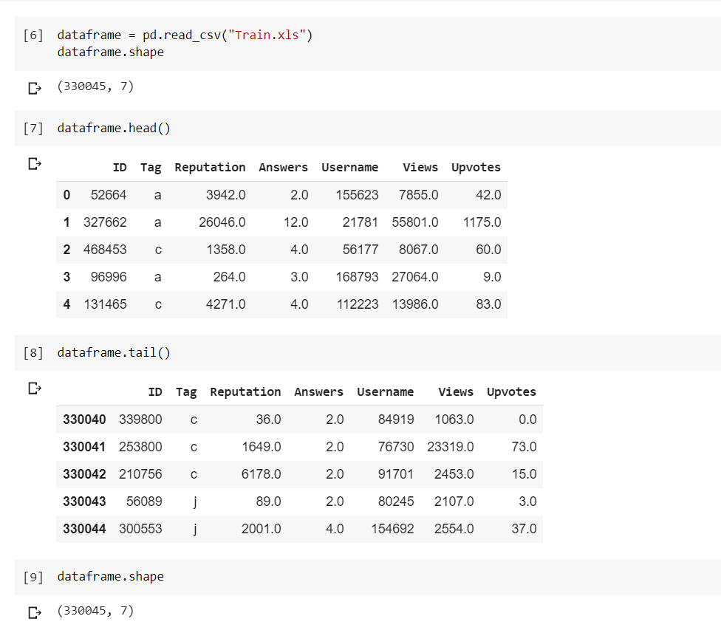
Step 1: Reading data
Downloading dataset through google drive into our machine.
Loading dataset in to a pandas dataframe.

Slide 7
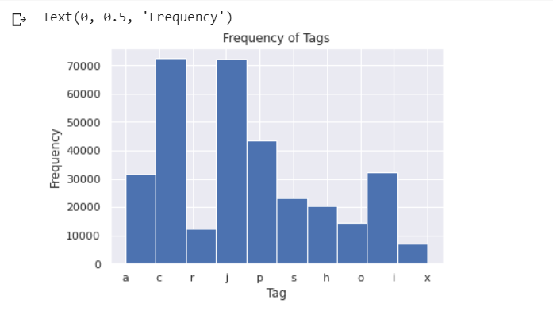
Step 2: Preprocessing data
Replacing Null values with mean of respective attribute.
Applying log to make the data normalized.
Scaling the data using MinMaxScaler.
One hot encoding the ‘Tag’ attribute.

Slide 8
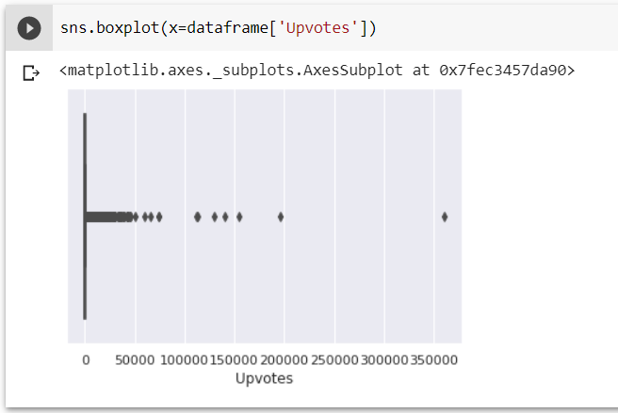
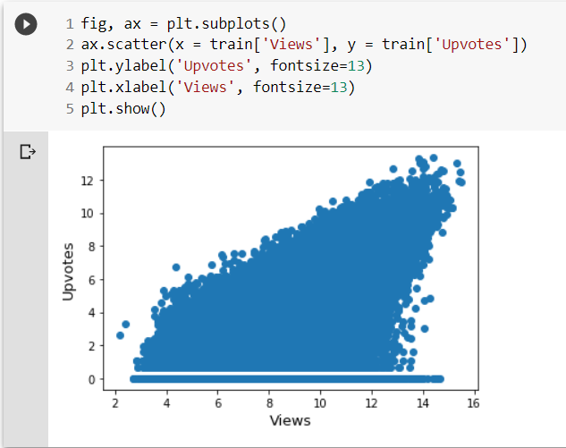
Step 3: Data visualization
Visualizing relationships between attributes of out dataframe.
First boxplot shows the presence of outliers.
Second scatterplot shows as the Views increases, the Upvotes increases too.

Slide 9
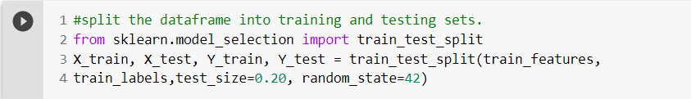
Step 4: Train test split
In this step we split our preprocessed dataframe into training and testing sets.
X_train, Y_train are used to train our model.
X_test, Y_test are used to calculate the accuracy of trained model.

Slide 10
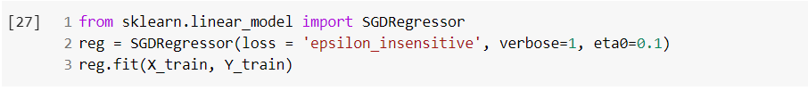
Step 5: Training the model
one of the most crucial step of the whole machine learning process.
X_train, Y_train are used to train the model.
The training dataset is traversed for certain number of epochs.
Values of the weight’s and bias’s are calculated for our approximation function until the loss is minimized.

Slide 11
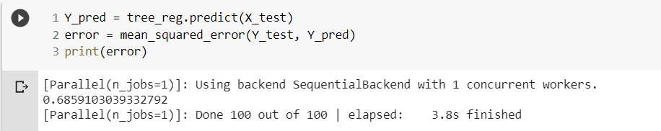
Step 6: Testing accuracy of trained model.
This step comes after model training.
X_test, Y_test are used to test the model accuracy.
Approximated values of Upvotes is predicted and compared against true value of Upvotes.
Mean squared error is calculated.

Slide 12
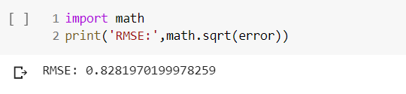
Step 7: Evaluation
Evaluation metric used here is R.M.S.E.
Used here because large errors are not occurring.
M.A.E (Mean Absolute Error) is also calculated.
Both are negatively oriented scores. Lower values the better.

Slide 13
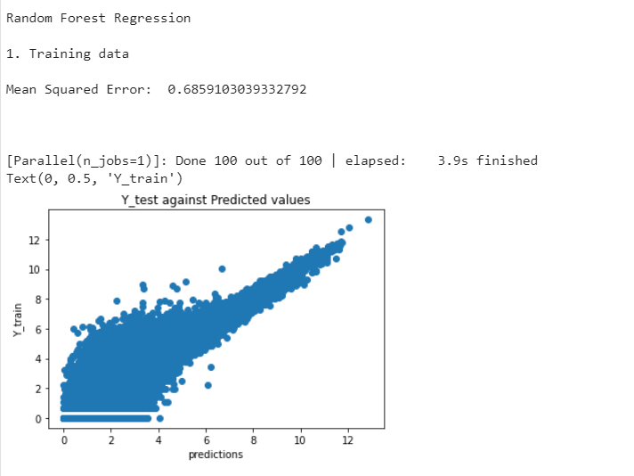
RESULT
Successfully predicted Upvotes.
Random forest regression produced better accuracy than Stochastic gradient descent.
Mean squared error of 0.68591 was observed.

Slide 14
THE END.

